Slide 1
Conservation of Mechanical Energy
Chapter 6

Slide 2
Energy
As you know, energy comes in many forms.
Kinetic Energy
Potential Energy
Gravitational Potential Energy (gravity)
Elastic Potential Energy (springs, rubber bands)
Chemical Energy (chemical bonds)
Rest Mass Energy = Nuclear (E = mc²)
Electric Potential Energy (ΔU = kq₁q₂/r)
Thermal Energy (heat = KE of molecules)
Sound (waves)
Light (waves/photons)
What does it mean to conserve energy?

Slide 3
Conservation of Energy
The Law of Conservation of Energy simply states that:
The energy of a system is constant.
Energy cannot be created nor destroyed.
Energy can only change form (e.g. electrical to kinetic to potential, etc).
True for any system with no external forces.
E_{Total} = KE + PE = Constant
KE = Kinetic Energy
PE = Potential Energy

Slide 4
Conserved Quantities
Some conserved quantities that you may or may not already be familiar with?
Conservation of mass.
Conservation of momentum.
Conservation of charge.

Slide 5
Conservation of Energy
Energy
Mechanical
Non-mechanical
Kinetic
Potential
Gravitational
Elastic

Slide 6
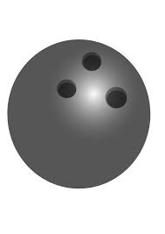
E_{T} = KE + ΣPE = Constant
What does it mean if the energy of a system is constant?
If the Potential Energy is at a maximum, then the system will have minimum Kinetic Energy.
If the Kinetic Energy is at a maximum, then the system will have minimum Potential Energy.
PE_{Max}
KE_{Min}
PE_{Min}
KE_{Max}

Slide 7
Conservation of Mechanical Energy
E_{T} = KE + PE
KE_{initial} + PE_{initial} = KE_{final} + PE_{final}

Slide 8
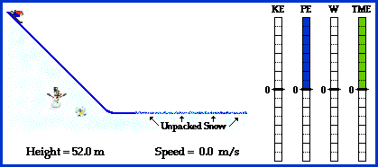
Conservation of Mechanical Energy – Skier
Critical points to consider
PE max
Heat (Q)
Work don by friction
Total Mechanical Energy
KE max
Total Mechanical Energy = PE + KE
When friction is present:
E_{Total} = KE + PE + Q
Friction is a non-conservative force that takes energy from the system

Slide 9
Example 1:
A student with a mass of 55 kg starts from rest and slides down a frictionless slide that is 3 meters high.
What is the student’s kinetic energy at the bottom of the slide.
What is the student’s speed at the bottom of the slide?
KE_{initial} + PE_{initial} = KE_{final} + PE_{final}
KE_{initial} = 0 because v is 0 at top of slide.
PE_{initial} = mgh
KE_{final} = ½ mv²
PE_{final} = 0 at bottom of slide.

Slide 10
Example 1 (cont.)
PE_{initial} = KE_{final}
mgh = KE_{final}
KE_{final} = (55kg)(9.81m/s²)(3.0m)
KE_{final} = 1620 Joules
KE_{final} = ½mv²
v = 2KE/m
v = (2)(1620J)/(55kg)
v = 7.67 m/s
√
√

Slide 11
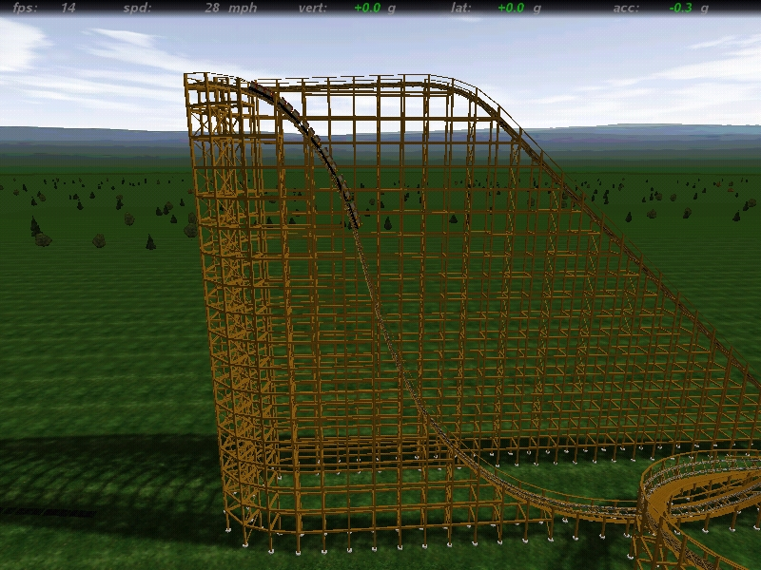
Example 2:
El Toro goes through a vertical drop of 50 meters. Using the conservation of energy, determine the speed at the bottom of the drop. Assume that the initial speed of the coaster is 0 m/s.

Slide 12
The conservation of energy says that the kinetic energy at the bottom of the drop will equal the gravitational potential energy at the top.
$$KE = PE$$
$$½ mv2 = mgh$$
Divide both sides by m to get:
$$½ v2 = gh$$
Then multiply both sides by 2 to get:
$$v2 = 2gh$$
Take the square root of both sides to get:
$$v = \sqrt{2gh }$$
$$v = \sqrt{(2)(9.81 m/s2)(50 m)}= 31.3 m/s (69.3 mph)$$

Slide 13
Example 3:
A student with a mass of 55 kg starts from rest and slides down a non-frictionless slide that is 3 meters high.
Compared to a frictionless slide the student’s speed will be:
the same.
less than.
more than.
Why?
Because energy is lost to the environment in the form of heat due to friction.

Slide 14
Example 3 (cont.)
Does this example reflect conservation of mechanical energy?
No, because of friction.
Friction causes energy to flow from the system to the environment.
Is the law of conservation of energy violated?
No: as previously stated, some of the “mechanical” energy is lost to the environment in the form of heat.

Slide 15
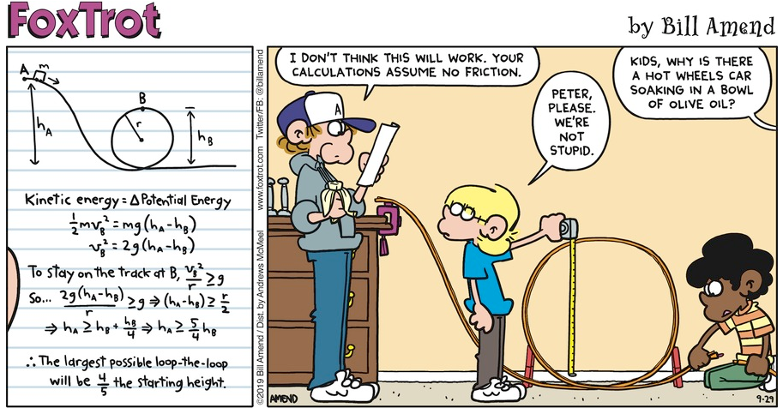

Slide 16
Conservation of Mechanical Energy
Mechanical Energy:
If Internal Energy(Q) is ignored:
E_{T} = KE + GPE + PE_{s}
PE could be a combination of gravitational and elastic potential energy, or any other form of potential energy.

Slide 17
Conservation of Mechanical Energy – The Roller Coaster
www.howstuffworks.com

